Slide 1
Mid-Module Presentation
Rhea Nair, Samiksha Sarda, Sana Sawant, Vedika Khandelwal
MGT 5905 - Business Analytics Capstone
Spring 2025
Notes:
Good evening, everyone.
Today, we are going to present our progress on the project.
I’m Samiksha, and I’m joined by my teammates Rhea, Sana, and Vedika.
We’ve been working on uncovering customer behavior insights using transaction data from an online wholesale retailer.
To begin, let’s walk through the business understanding and the core objective guiding our analysis.

Slide 2
Business Understanding
In a rapidly evolving digital commerce landscape, how can we leverage historical transaction data to uncover behavioral economics behind purchasing patterns, customer value, and lifecycle shifts and translate this into sustainable competitive advantage for a niche online wholesale retailer?
Our goal is to build a comprehensive customer intelligence study that not only describes what is happening in the business, but diagnoses why it’s happening, prescribes what should be done next, and predicts what lies ahead.
Notes:
In today’s fast-evolving digital commerce space, understanding customer behavior is crucial for long-term growth.
The key question driving our project is:
How can we leverage historical transaction data to understand customer purchasing patterns, value, and lifecycle — and use these insights to build sustainable competitive advantage for a niche online wholesale retailer?
Our goal is to create a comprehensive customer intelligence study that not only explains what is happening but also helps understand why, what to do next, and what to expect in the future.
With that vision in mind, let’s look at the data we’re working with.

Slide 3
Data Understanding
This Online Retail II data set contains comprises of 1,033,036 transactions occurring for a UK-based and registered, non-store online retail between Dec’09 and Dec’11. The company mainly sells unique all-occasion giftware to wholesalers.
Challenges of the dataset include:
Missing values: 200,000+ in Customer ID and 5000+ missing product descriptions.
Description column: illegible product descriptions (eg: “????”, “?damage??”), damaged and returned product entries, postage costs, and non-product based costs (“missing”)
Stock code column: Non-Product ID based codes, including M (“manual”), DOT (“dotcom postage”), B(“Bad Debt”), C(“Cancelled”)
Quantity and Price had huge negative values and 1000’s of outliers
Despite these issues, the dataset provides very intensive and detailed information for various business domains including product, customer and pricing and demand analysis.
Notes:
The dataset — Online Retail II — includes over 1 million transactions for a UK-based non-store online retailer between December 2009 and December 2011. The company primarily sells giftware to wholesale customers.
While the dataset is rich and detailed, it came with several challenges:
Over 200,000 missing customer IDs and thousands of missing or unreadable product descriptions
Non-standard product codes, including entries like “M” for manual or “B” for bad debt
Negative and zero values in Quantity and Price, along with numerous outliers
Despite these challenges, the dataset provides great potential for insights into product performance, pricing, and customer behavior.
To make the most of it, we first had to clean and structure the data. Let’s now look at how we approached that in the preparation phase.

Slide 4
Data Preprocessing
We combined multiple Excel sheets into one unified DataFrame and Dropped duplicates based on Invoice No and date.
Removed rows with:
Illegible Product Descriptions for e.g., “????”, “?damage??”, “missing”
Non-product Stock Codes for eg,B (bad debt), C (canceled)
Negative or zero Quantity/Price
Created new variables:
TotalPrice = Quantity × UnitPrice
Filtered for positive-value transactions to focus on valid purchases
Notes:
To prepare the data for analysis, we first combined multiple Excel sheets into one unified DataFrame. Then, we removed:
Duplicates based on invoice number and date
Rows with unreadable or placeholder descriptions like “????” or “missing”
Non-product stock codes such as “B” for bad debt and “C” for canceled entries
Transactions with zero or negative Quantity or Price
We also created a new variable — TotalPrice — to capture the overall value of each transaction, calculated as Quantity multiplied by Unit Price.
Finally, we filtered for valid, positive-value purchases to ensure that our analysis would be grounded in real, interpretable transactions.
With a clean dataset in place, we moved into exploratory analysis to uncover patterns and clean outliers. Let’s walk through that next.

Slide 5
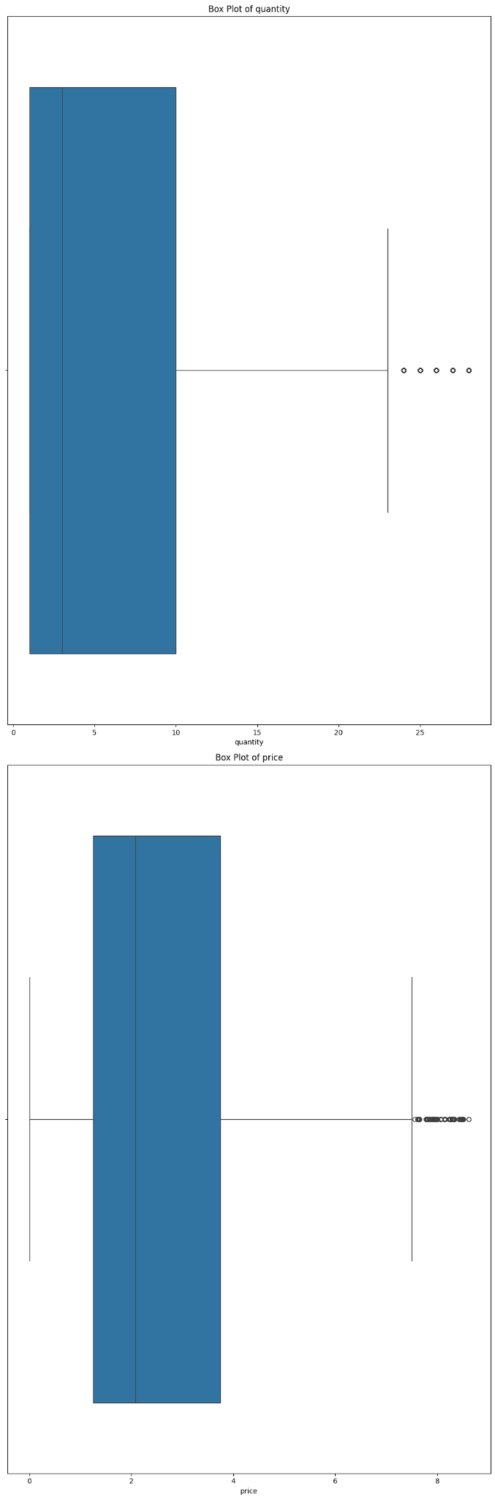
Exploratory Data Analysis
Outliers removed: 140,870
Notes:
Here, we conducted exploratory analysis using box plots to examine the distribution of Quantity and Price — after removing outliers.
Initially, both fields showed heavy skewness and extreme values. After removing the outliers, we noticed more stable and interpretable distributions. This step was critical to ensure that downstream analysis, like customer value modeling, wouldn’t be distorted by anomalous entries.
This foundational cleaning allows us to generate more meaningful visualizations and business insights — which we’ll showcase in the next slide.

Slide 6
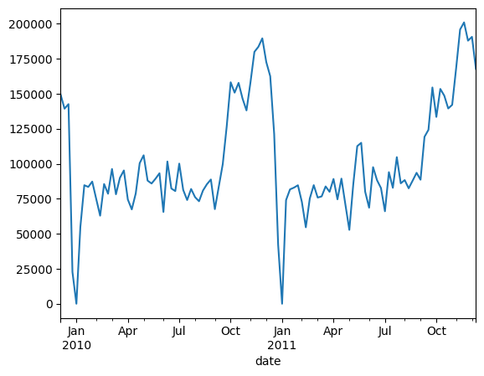
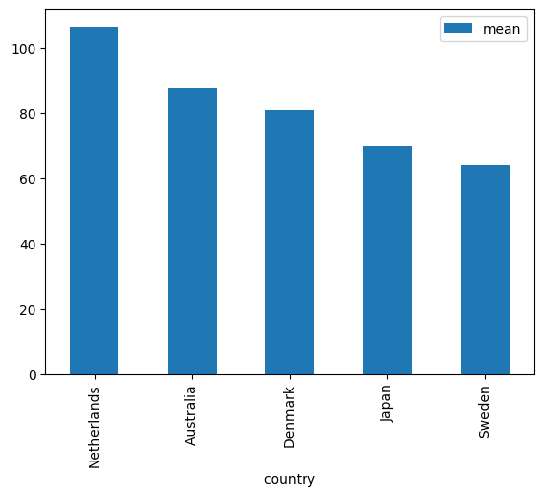
Data Analysis & Strategy
Avg Daily Sales by Week
Avg Sales by Country
Notes:
With our cleaned dataset, we generated the following insights:
On the left, we have Average Daily Sales by Week — which reveals seasonal trends, especially a sales spike during the holiday season in late 2011. Dips in mid-year and post-holiday periods further highlight predictable seasonality.
On the right, we explored Average Sales by Country. While the UK dominates in volume, countries like Netherlands, Australia, and Denmark stand out in terms of higher per-transaction sales — indicating potential for targeted strategies in those regions.
These insights mark just the beginning. In the next phase of the project, we will dive deeper into customer segmentation and predictive modeling to enhance customer retention and business growth.

Slide 7
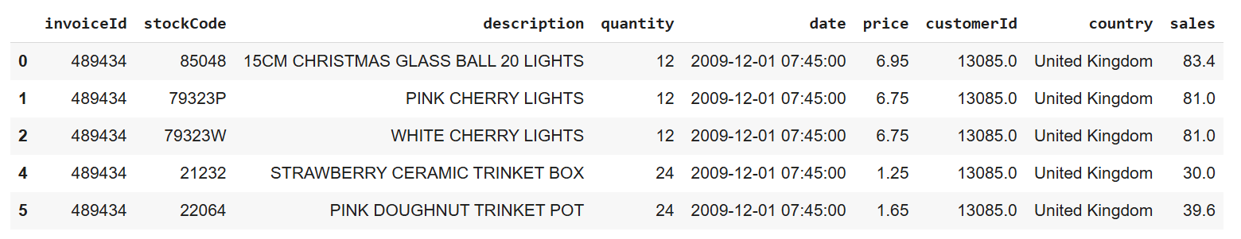
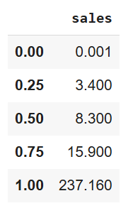
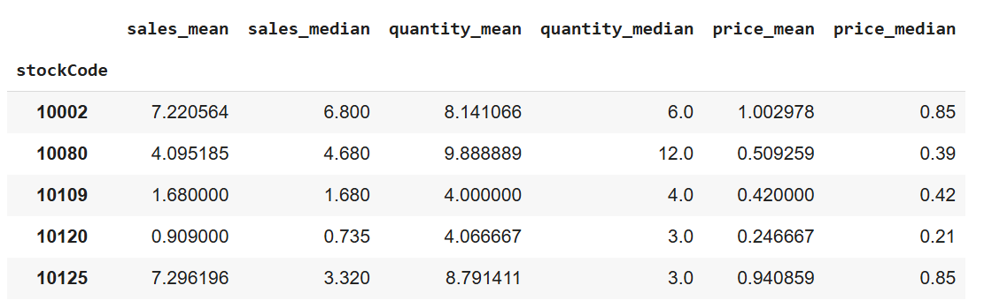
Descriptive Statistics
Item-level analysis data
Quartile for sales
Descriptive statistics for sales
Notes:
"In this slide, we’re starting with a quick look at the data we're working with.
The dataset contains about 40,000 unique invoices, nearly 5,000 unique stock ID, and around 5,400 product descriptions.
We also have records from about 5,800 customers across 43 different countries.
In the main table above, we see an example of the item-level data. It includes the invoice ID, product, quantity, price, and a calculated sales column — which is simply price multiplied by quantity.
To better understand sales behavior, we looked at sales distribution using quartiles:
25% of sales are below £3.40, and 50% are below £8.30.
The top 25% of sales go above £15.90, and the highest sale value in the data is over £237 — meaning a few transactions bring in significantly more revenue.
Then, we aggregated stats for each product to see how they perform on average.
The average sales is 12.05
For example, item 10002 has an average sale of £7.22 with an average of about 8 units sold.
Overall, this gives us a solid foundation for understanding the variety and performance of products in the dataset."

Slide 8
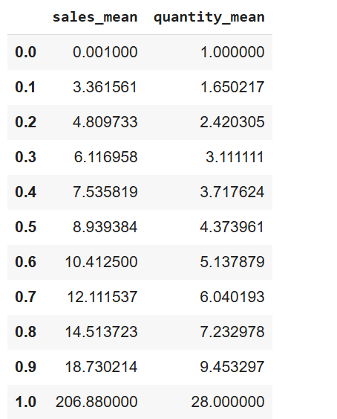
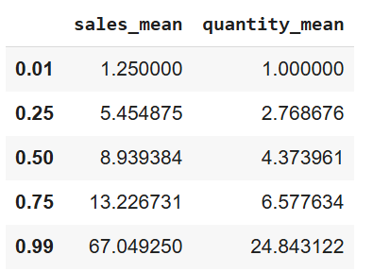
Distribution
Decile for sales mean and quantity mean
Quartile for sales mean and quantity mean
Notes:
In this slide, we analyzed the distribution of item-level sales and quantity using both quartiles and deciles.
On the right, we have the quantile summary, which includes key percentiles like the 1st, 25th, 50th, 75th, and 99th:
The median sales_mean is around £8.94, and the median quantity_mean is about 4.37.
This means that, typically, an item sells for just under £9 and sells about 4 units on average.
However, the 99th percentile for sales_mean shoots up to over £67, and for quantity_mean it goes up to 24.84, indicating a long right tail — meaning a small number of items contribute disproportionately high sales.
On the left, we explored this further using deciles, dividing the data into 10 equal parts.
This gives a more granular view and shows that items start gaining momentum in sales and quantity from the 60th percentile onward.
For example, by the 90th percentile, average sales jump to over £18.73, and average quantity reaches 9.45.
The top 10% of items are significantly outperforming the rest, with the top 1% having an average sale as high as £206.88.
🔍 1. Most Products Are Low Sellers
The average item sells for around £9 and 4 units — meaning most products are low-to-medium performers.
📈 2. A Small Group of Items Drive High Sales
The top 1% of items can have average sales as high as £206.88.
This shows a long tail distribution — a few items contribute disproportionately high revenue.
📊 3. Sales Acceleration Starts Midway
From the 60th percentile onward, sales and quantity increase sharply.
Focused marketing on products above this threshold could boost overall performance.
🎯 4. Target Top-Performing Items for Promotions
The top 10% of products sell significantly more — they’re ideal for:
Cross-selling
Bundling

Slide 9
Customer Categorization- Recency Frequency and Monetary Analysis
RFM Analysis is a customer value based segmentation technique used in marketing and analytics. It categorizes customers based on their purchasing behavior using three key factors:
Recency- Number of days since the last purchase per customer
Frequency- Total number of purchases per customer
Monetary- Total amount spent per customer
It’s purpose is to identify high-value customers and support targeted marketing strategies aimed at improving customer retention, engagement, and profitability.

Slide 10
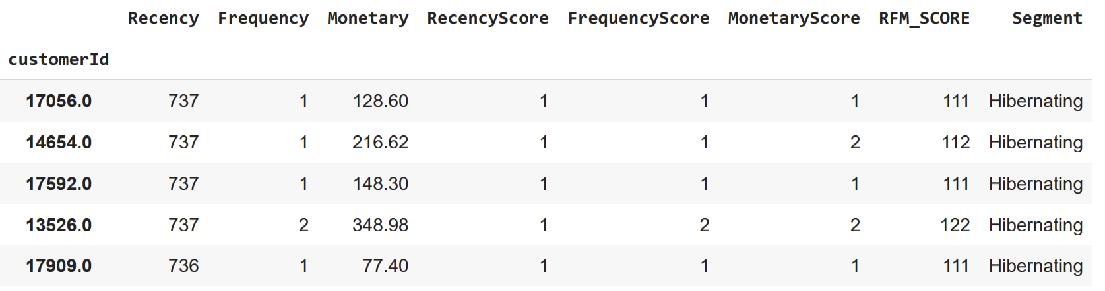
…Continued
Step 1: Calculate Recency, Frequency and Monetary scores for each customer
Step 2: Assign Scores
Score each metric on a scale (commonly 1 to 5) thorough quartile-based binning
Higher scores represent more desirable behavior
Step 3: Combine RFM Scores
Create a 3-digit score (e.g., 545)
Each score represents the customer’s position in Recency, Frequency, and Monetary
Step 4: Group customers into the 10 categories

Slide 11
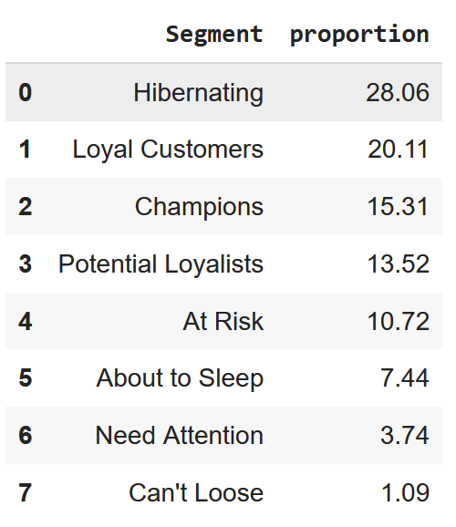
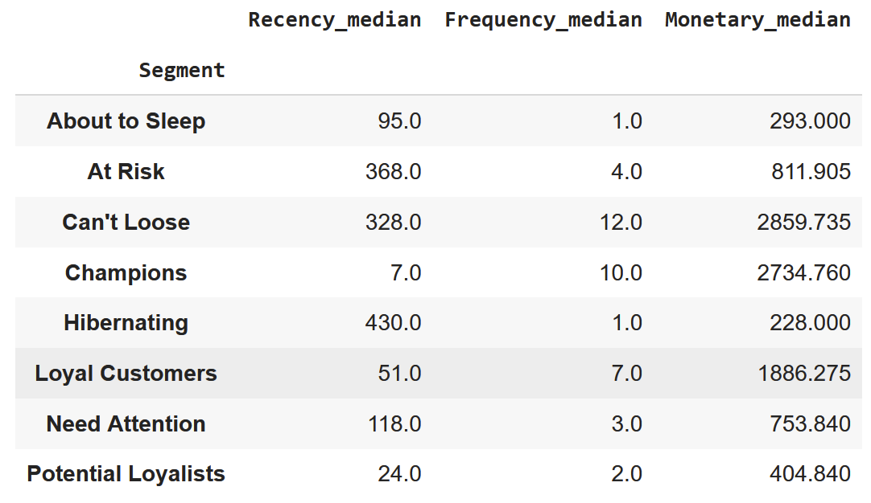
…Continued

Slide 12
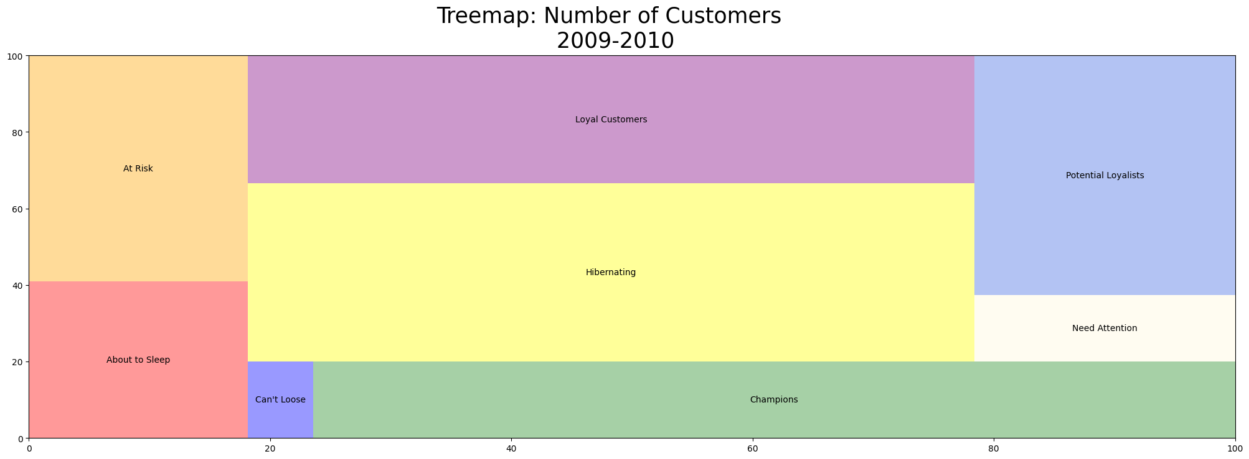
…Continued

Slide 13
Product Bundling- Apriori Market Basket
A priori is from Latin ā priōrī, which means literally, "from what is earlier." A priori knowledge is knowledge that comes from the power of reasoning based on self-evident truths
The Apriori algorithm is used for association rule mining that identifies frequent itemsets and association rules in a dataset, particularly useful for applications like market basket analysis
It identifies which items are frequently bought together by analyzing transactions using three key concepts:
Support – How often items appear together
Confidence – How often item B appears after item A
Lift – How much more likely B is bought when A is bought

Slide 14

Support
Support tells us how often items or itemsets appear in the dataset (i.e., transactions). It helps us find frequently purchased items or item combinations.
Antecedent | Consequent | Antecedent Support | Consequent Support | Support
ALARM CLOCK PINK | ALARM CLOCK GREEN | 0.076522 | 0.071304 | 0.055652

Slide 15
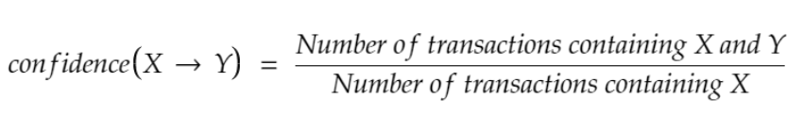
Confidence
It is the likelihood that item Y is also bought if item X is bought. It’s calculated as the number of transactions containing X and Y divided by the number of transactions containing X.
Antecedent | Consequent | Antecedent Support | Consequent Support | Support | Confidence
ALARM CLOCK PINK | ALARM CLOCK GREEN | 0.076522 | 0.071304 | 0.055652 | 0.72723

Slide 16
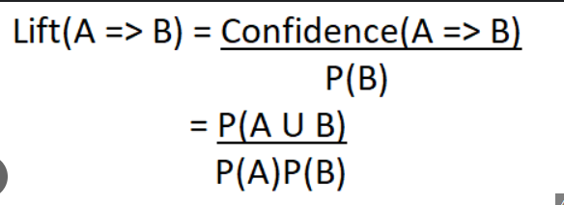
Lift
Measures how much more likely Y is purchased when X is purchased, compared to random chance
Antecedent | Consequent | Antecedent Support | Consequent Support | Support | Confidence | Lift
ALARM CLOCK PINK | ALARM CLOCK GREEN | 0.076522 | 0.071304 | 0.055652 | 0.72723 | 10.1995

Slide 17
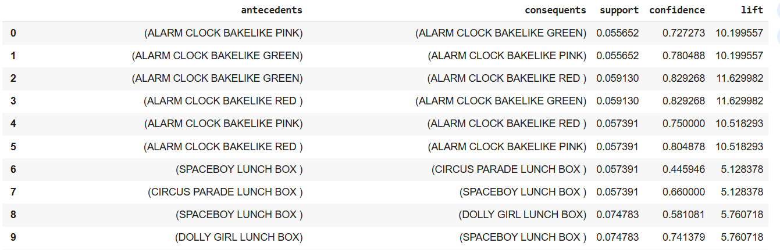
Output and Interpretation
With a support of 0.05

Slide 18
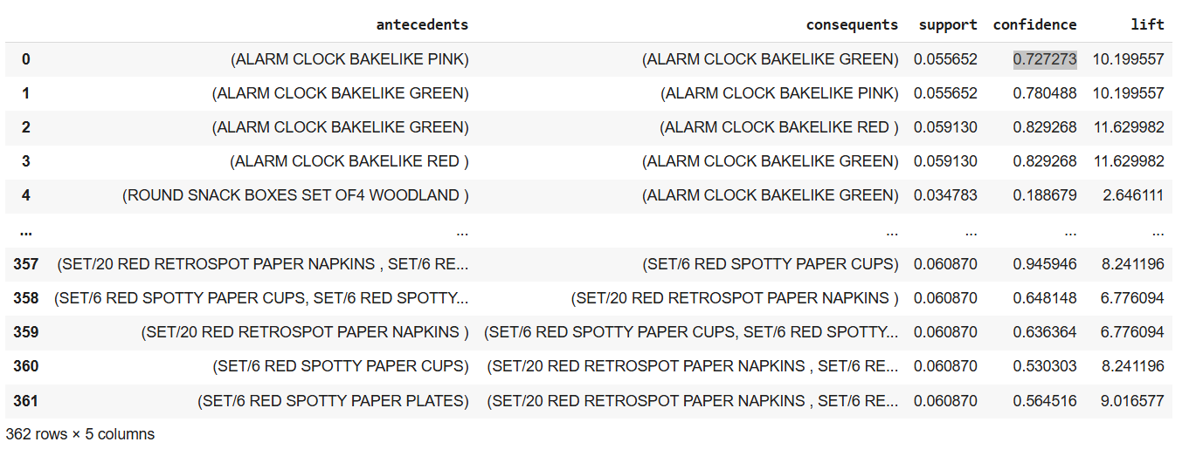
Output and Interpretation
With a support of 0.02

Slide 19
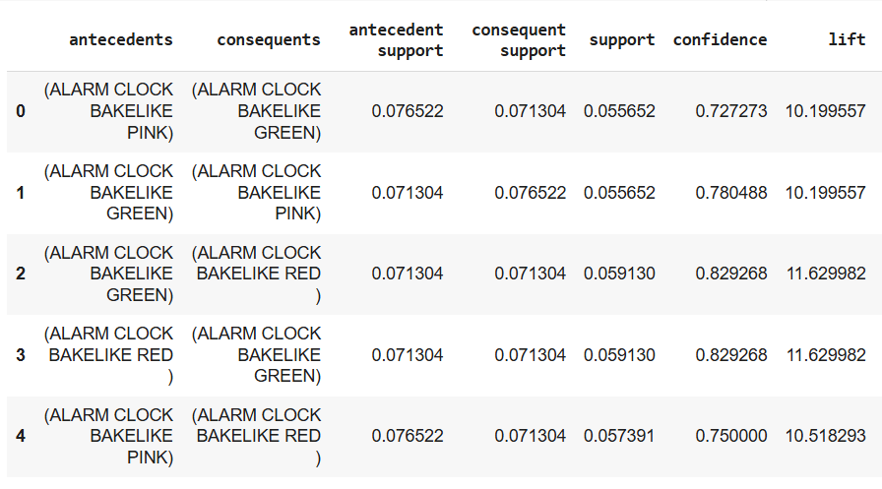
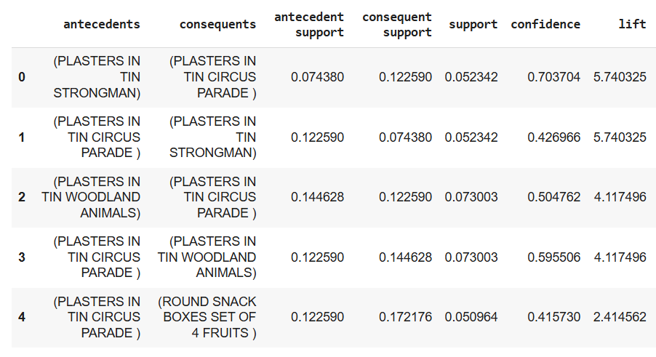
For Different Countries
For France:
For Germany:

Slide 20
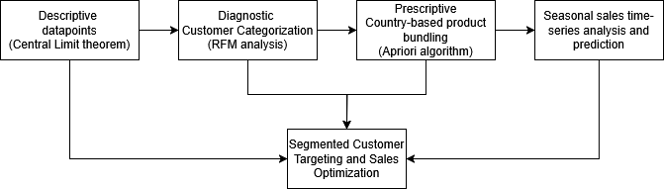
How it all Connects?

Slide 21
Future Steps
Combine RFM with Apriori Insights
Sales Improvement through Seasonal Patterns, Customer Categorization & Product Bundling
Tailored Marketing Strategy
Business Integration through Dashboarding
Notes:
Combine RFM with Apriori Insights "We'll merge our RFM segmentation results with the outcomes of our Apriori market basket analysis. This will help us understand which product combinations are most relevant to each customer segment, allowing us to design more effective cross-selling and upselling strategies."
Sales Improvement through Seasonal Patterns, Customer Categorization & Product Bundling "We’ll dive into seasonal trends to identify peak periods and optimize marketing and inventory planning. By combining customer categorization from RFM with bundling insights from Apriori, we can create personalized bundles that boost sales and increase average order value."
Tailored Marketing Strategy "Using the insights from segmentation and product pairing, we’ll craft customized marketing messages and promotions for each segment. This personalization will help us drive better engagement, improve conversion rates, and ultimately grow customer loyalty."
Business Integration through Dashboarding "Finally, we'll bring all of this into an easy-to-use dashboard. This will allow stakeholders to explore the data, track key performance indicators, and make informed decisions based on real-time analytics."

